Slide 1

6th Grade Math
Unit 9, Lesson 5 Interpreting Box Plots Volume 2, pg. 166

Slide 2


Benchmark
MA.6.DP.1.3
Given a box plot within a real-world context, determine the minimum, the lower quartile, the median, the upper quartile, and the maximum. Use this summary of the data to describe the spread and distribution of the data.
volume 2, pg. 166

Slide 3
Integrated Mathematical Thinking and Reasoning Standards
MA.K12.MTR.2.1 Demonstrate understanding by representing problems in multiple ways.
MA.K12.MTR.3.1 Complete tasks with mathematical fluency.
MA.K12.MTR.7.1 Apply mathematics to real-world contexts.
volume 2, pg. 166

Slide 4

Learning Targets
I can determine the minimum, lower quartile, median, upper quartile, and maximum from a box plot.
I can determine the interquartile range from a box plot.
I can describe the spread and distribution of data from a box plot.
volume 2, pg. 166

Slide 5

Warm-Up
volume 2, pg. 167

Slide 6
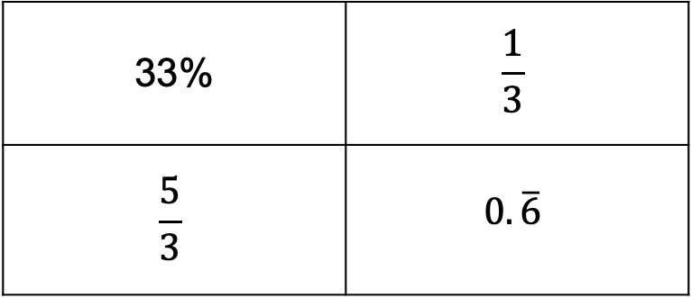
9.5.1 Warm-Up: Which One Doesn’t Belong?
Examine the four numbers.
Which of these numbers does not belong? Explain your thinking.
33% | $$\frac{1}{3}$$
$$\frac{5}{3}$$ | $$0.\overline{6}$$
volume 2, pg. 167

Slide 7

Exploration
volume 2, pg. 167

Slide 8

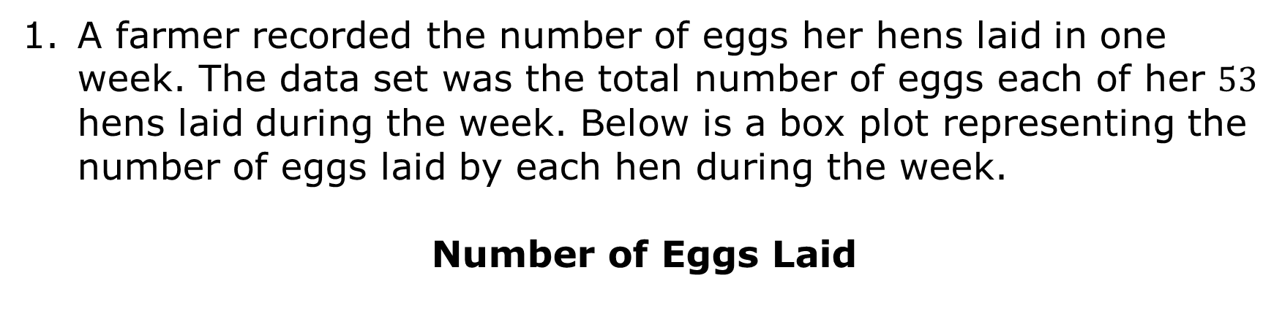
9.5.2 Exploration: Exploring Box Plots
A farmer recorded the number of eggs her hens laid in one week. The data set was the total number of eggs each of her $53$ hens laid during the week. Below is a box plot representing the number of eggs laid by each hen during the week.
Number of Eggs Laid
volume 2, pg. 167

Slide 9
With your partner, use the box plot to complete the statements.
The smallest number of eggs laid by the hens is ______.
The largest number of eggs laid by the hens is ______.
Find another pair of partners and compare the smallest and largest number of eggs laid. Discuss how you determined the values from the box plot. If your values are different, come to a consensus on the smallest and largest number of eggs laid by the hen, and circle these values on the box plot.
volume 2, pg. 167

Slide 10
Label the range for the number of eggs laid on the box plot.
With your partner, conjecture the median number of eggs laid. Label this number as “median” on the box plot.
volume 2, pg. 168

Slide 11
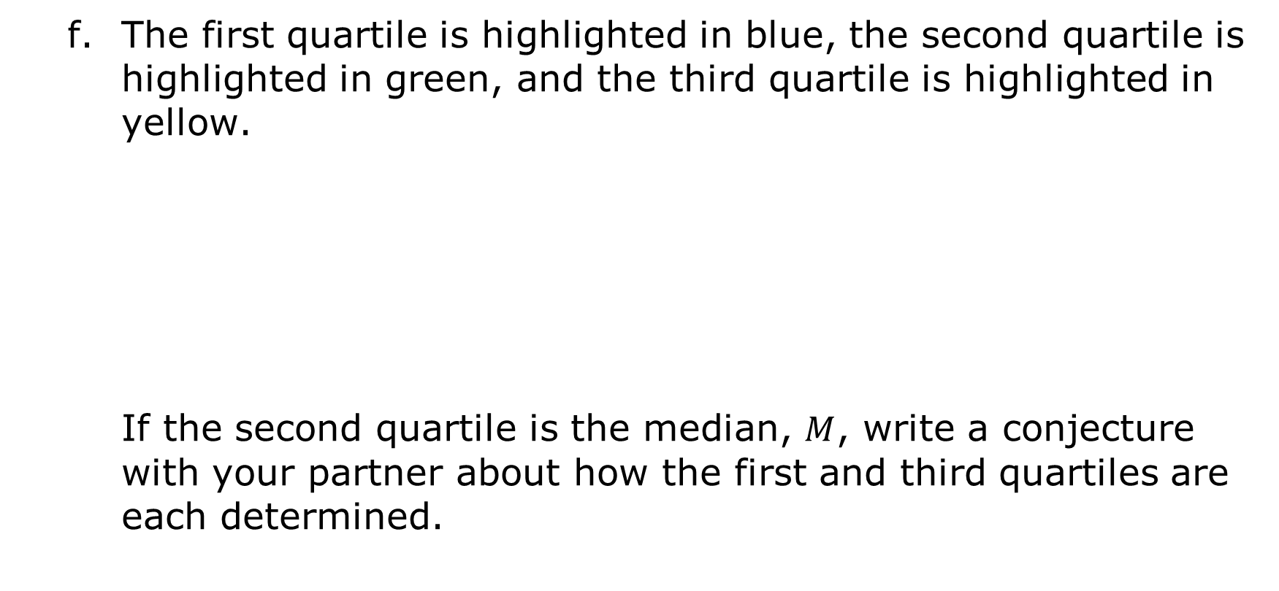
The first quartile is highlighted in blue, the second quartile is highlighted in green, and the third quartile is highlighted in yellow.
If the second quartile is the median, $M$, write a conjecture with your partner about how the first and third quartiles are each determined.
volume 2, pg. 168

Slide 12
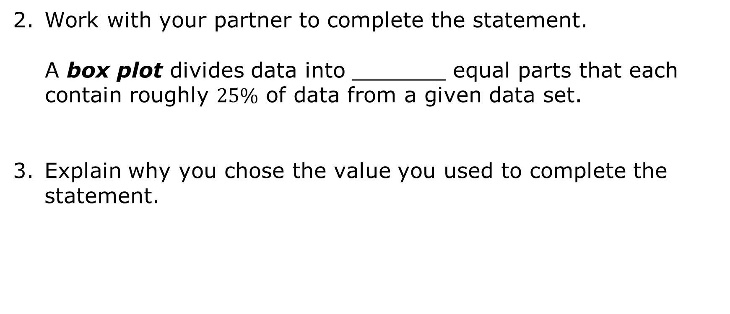
Work with your partner to complete the statement.
A box plot divides data into _______ equal parts that each contain roughly $25\%$ of data from a given data set.
Explain why you chose the value you used to complete the statement.
volume 2, pg. 168

Slide 13

Guided Instruction
volume 2, pg. 169

Slide 14

9.5.3 Guided Instruction: Interpreting Box Plots
A box plot is a plot displaying the spread or distribution of a data set using a five-number summary: the minimum, lower quartile (first quartile), median, upper quartile (third quartile), and maximum. It is also called a box-and-whisker plot.
volume 2, pg. 169

Slide 15
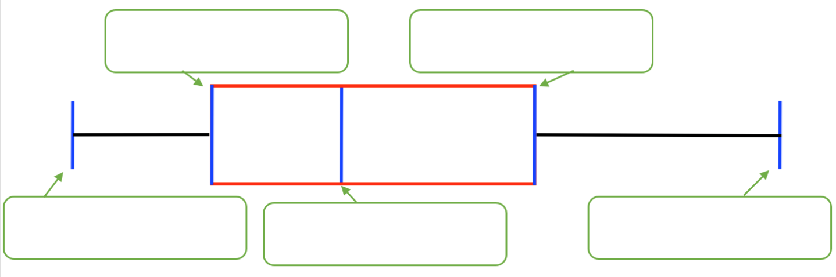
Label the maximum, minimum, median, first quartile, and third quartile on the box plot.
volume 2, pg. 169

Slide 16
Complete the statement.
The first quartile (Q1) is the middle value of
the data that are the median.
The third quartile (Q3) is the middle value of
the data that are the median.
less than
greater than
equal to
less than
greater than
equal to
volume 2, pg. 169

Slide 17
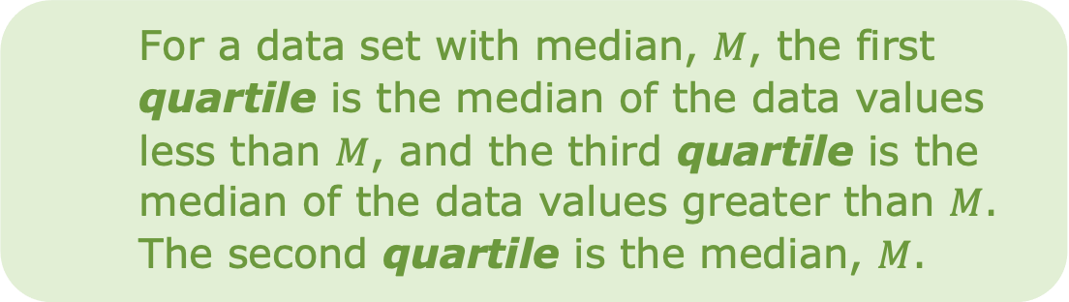
Complete the statement.
The measure of central tendency used to create a
box plot is the which divides the data set in half.
For a data set with median, $M$, the first quartile is the median of the data values less than $M$, and the third quartile is the median of the data values greater than $M$. The second quartile is the median, $M$.
mean,
median,
mode,
volume 2, pg. 169

Slide 18
A number line often accompanies a box plot and is used to determine the values associated with each part of the plot.
Another measure of variability like range, the interquartile range (IQR), can be found by determining the difference in the third quartile from the first quartile.
volume 2, pg. 169

Slide 19

A measure of variation in a set of numerical data, the interquartile range is the distance between the first and third quartiles of the data set.
IQR = (Q₃) - (Q₁)
volume 2, pg. 169

Slide 20
Revisit the box plot of the eggs laid by a farmer’s hens.
Number of Eggs Laid
What is the interquartile range (IQR) for the box plot of the context?
Label the IQR on the box plot.
volume 2, pg. 170

Slide 21

Guided Practice
volume 2, pg. 170

Slide 22

9.5.4 Guided Practice: Interpreting Box Plots
The average price of milk, in dollars ($), for each month from April 2000 to November 2006 was used to create the box plot shown.
Average Price of Milk ($)
$2.66
$2.78
$3.13
$3.57
$2.90
volume 2, pg. 170

Slide 23
What is the range of the data?
Determine the interquartile range.
Does the average cost of milk from April 2000 to November 2006 vary a lot or a little? Explain your reasoning.
volume 2, pg. 170

Slide 24

Try It
volume 2, pg. 171

Slide 25

9.5.5 Try It: Interpreting Box Plots
The box plot displays data on the response times of 100 mice when seeing a flash of light.
Response Time (in seconds)
volume 2, pg. 171

Slide 26
Complete the statements.
The fastest response time is ______ seconds.
The slowest response time is ______ seconds.
The middle response time is ______ seconds.
The lower quartile is ___________ seconds.
The upper quartile is ___________ seconds.
The range is __________ seconds.
The interquartile range is _________ seconds.
Response Time (in seconds)
volume 2, pg. 171

Slide 27
With your partner, use the values to write a description of the spread and distribution of response times.
Response Time (in seconds)
volume 2, pg. 171

Slide 28
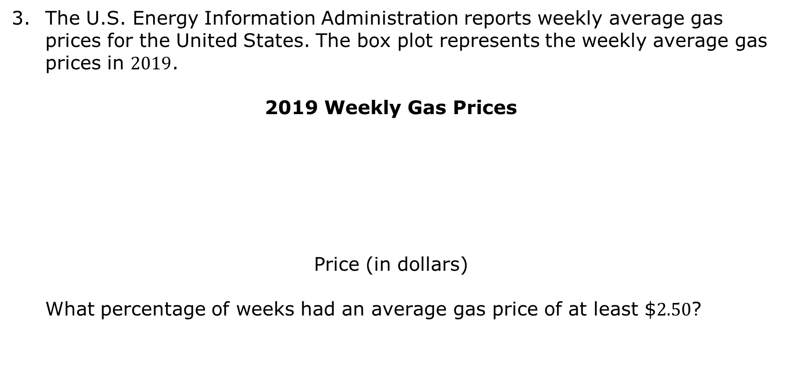
The U.S. Energy Information Administration reports weekly average gas prices for the United States. The box plot represents the weekly average gas prices in $2019$.
2019 Weekly Gas Prices
Price (in dollars)
What percentage of weeks had an average gas price of at least $$2.50$?
volume 2, pg. 171

Slide 29

Your Turn
volume 2, pg. 172

Slide 30
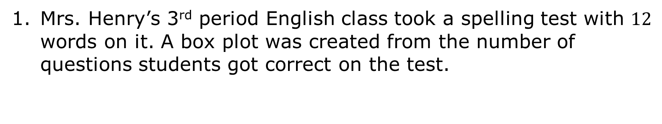
9.5.6 Your Turn!
Mrs. Henry’s 3rd period English class took a spelling test with $12$ words on it. A box plot was created from the number of questions students got correct on the test.
Number of Correct Questions
volume 2, pg. 172

Slide 31
Number of Correct Questions
Complete the statements.
The lowest score is ______.
The highest score is ______.
The middle score is ________.
The lower quartile is ___________.
The upper quartile is ___________.
The range is __________.
The interquartile range is _________.
volume 2, pg. 172

Slide 32
Number of Correct Questions
Write a description of the spread and distribution of the scores.
volume 2, pg. 172

Slide 33
The librarian at Franklin Middle School surveyed students when they returned from summer break on how many books they had read. She created a box plot to represent the results of her survey.
Number of Books Read
volume 2, pg. 172

Slide 34
Number of Books Read
What percentage of students read between:
5 and 10 books over the summer? ________
10 and 15 books over the summer? ________
5 and 6 books over the summer? ________
2 and 10 books over the summer? ________
volume 2, pg. 172

Slide 35

Wrap-Up
volume 2, pg. 173

Slide 36
9.5.7 Wrap-Up: Cool Down
Jamal missed class today and he needs help with what he missed.
Write a note to Jamal letting him know what a box plot is and what is it used for. Draw a picture or diagram that may help him better understand.
volume 2, pg. 173

